Slide 1
BinarX Summer 2024 School Holiday Program
Introduction to Electronic Design
January 2024
Fergus Downey and Jacob Cook

Slide 2
Objectives
Familiarise ourselves with the fundamentals of electric circuits
Ohms law
Power (voltage x current)
Series and parallel
How to wire up a basic digital circuit
Schematics
Three basic circuits (resistor divider and Op-amp)
Power and ground (decoupling capacitor)
Breadboard
Protoboard
Measuring voltages and short circuits with a Multimeter

Slide 3
Ohms Law
The foundations of all electronics:
V = I x R
V is Voltage, I is Current, and R is Resistance
We use I for Current because it was termed by a French physicist who named it “Intensite du courant”
Will explain this term a little more with some examples later

Slide 4
Power
Power is a term you should all be familiar with
P = V x I
The unit for P is Watt or Watts
Use this in everyday life when your parents pay the power bill
This is presented in Watt hours which represent the power used for a month

Slide 5
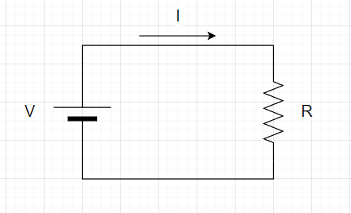
Example
Here is a basic schematic
We have a voltage source (V), a resistance or load (R), and the current flowing through the circuit (I)
Example:
If we have a 5V battery connected to a 5Ω resistor, how much current is in the circuit and how much power is it using?
To find the current we use V = I x R
5 = I x 5 making I = 1A
To find the power we use P = V x I
P = 5 x 1 making P = 1W

Slide 6
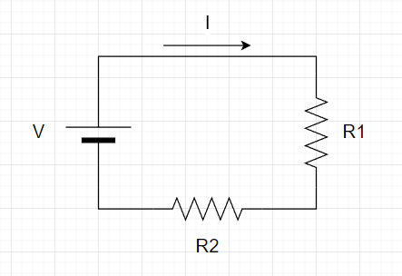

Series resistance example
Same schematic but this time we have two resistors in series!
For resistors in series, we add them together:
$$R_{T}=R_{1}+R_{2}+⋯+R_{n}$$
In series the current is the same, but the voltage is divided between the resistors

Slide 7
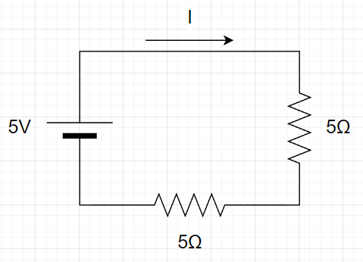
Series resistance example
Example:
If we have a 5V battery connected to two 5Ω resistor, how much current is in the circuit and how much power is it using?
To find the resistance we add R1 and R2
R = R1 + R2 = 10Ω
To find the current we use V = I x R
5 = I x 10 making I = 0.5A
To find the power we use P = V x I
P = 5 x 1 making P = 2.5W

Slide 8
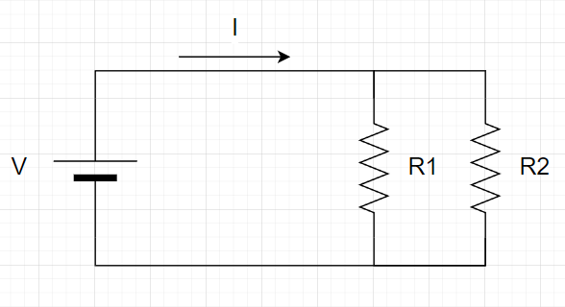

Parallel resistance example
Same schematic but this time we have two resistors in parallel!
For resistors in parallel we use the parallel resistance equation:
$\frac{1}{R_{T}}= \frac{1}{R_{1}}+\frac{1}{R_{2}}+⋯+\frac{1}{R_{n}}$
In parallel the voltage stays the same, but the current is divided between the resistors

Slide 9
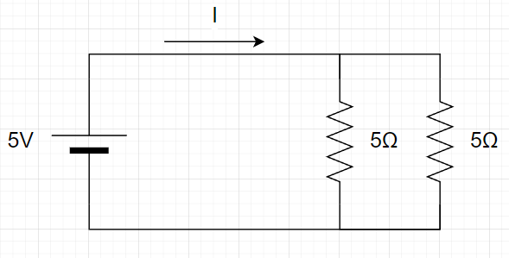

Parallel resistance example
Example:
If we have a 5V battery connected to two 5Ω resistor, how much current is in the circuit and how much power is it using?
To find the resistance we use the equation
$\frac{1}{R_{T}}= \frac{1}{5}+\frac{1}{5}$ which means $R_{T}=2.5$
To find the current we use V = I x R
5 = I x 2.5 making I = 2A
To find the power we use P = V x I
P = 5 x 2 making P = 10W

Slide 10
How to wire up a digital circuit
First, we need a schematic
Schematics are what we have seen in the previous examples
They show how to connect and wire up electrical components to make the desired circuit
Connections are shown through lines which represent wires
Different symbols are used for different components

Slide 11



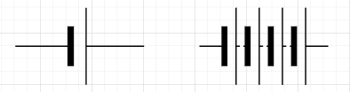
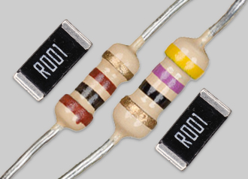

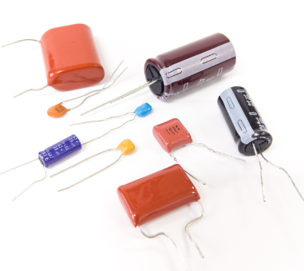


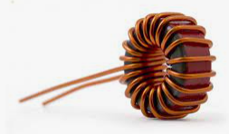
How to wire up a digital circuit
Common schematic symbols
Batteries
Resistors
Capacitors
Inductors

Slide 12

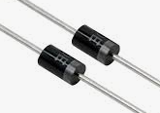
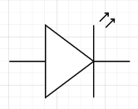
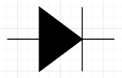
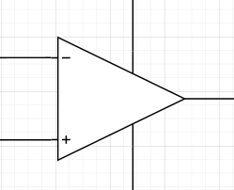
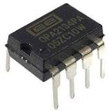

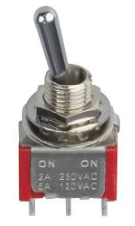

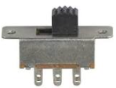
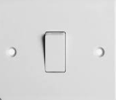
How to wire up a digital circuit
Common schematic symbols
LEDs and Diodes
Op-amps and Integrated Circuits (ICs)
Ground
Switches

Slide 13
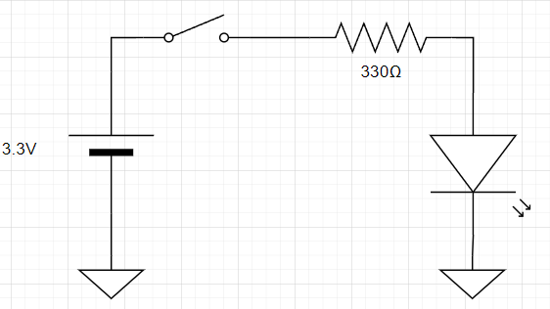

How to wire up a digital circuit
Schematic Example 1: LEDs
$$I=\frac{V}{R}$$
$$I=\frac{3.3}{330}$$
$$I=10mA$$

Slide 14
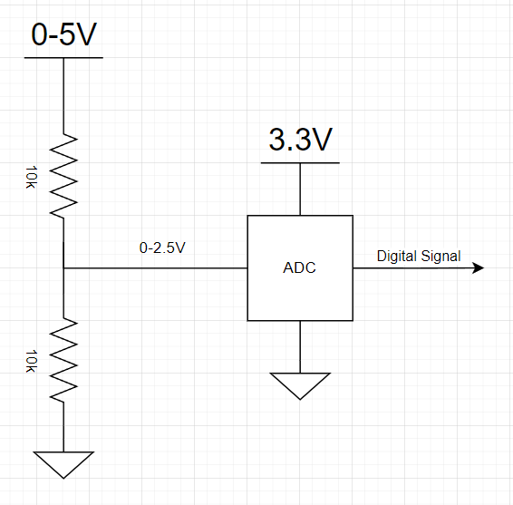

How to wire up a digital circuit
Schematic Example 2: Voltage Divider
$V_{OUT}=V_{IN}\left(\frac{R_{2}}{R_{1}+R_{2}}\right)$
$$V_{OUT}=5 \left(\frac{10}{10+10}\right)$$
$V_{OUT}=2.5$V

Slide 15
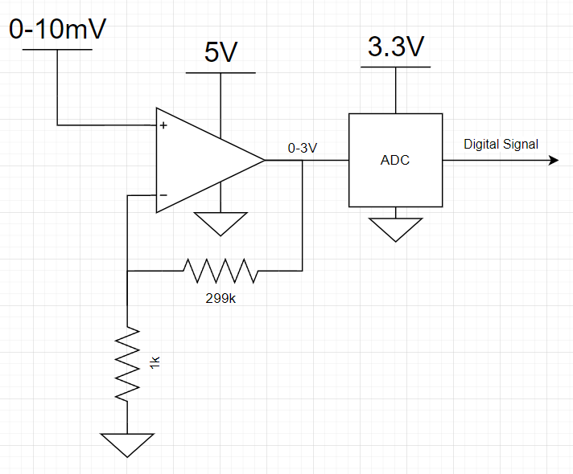

How to wire up a digital circuit
Schematic Example 3: Non-inverting Op-amp
$$V_{OUT}=V_{IN}\left(1+\frac{R_{f}}{R_{IN}}\right)$$
$V_{OUT}=0.01\left(1+\frac{299}{1}\right)$
$$V_{OUT}=3V$$

Slide 16
How to wire up a digital circuit
Final thing to mention is power and ground
In these schematics we make an assumption that all power is at a steady state
In the real world, this is not the case as we connect and disconnect power sources
As such we commonly connect a capacitor between power and ground to prevent large voltage spikes when connecting circuits to power
Keep this in mind when wiring up your circuits!

Slide 17
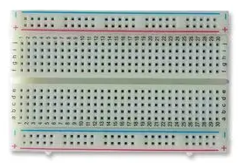
Breadboard

Slide 18
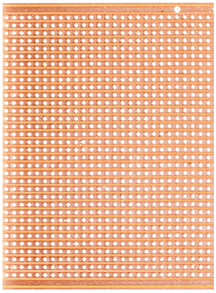
Protoboard

Slide 19
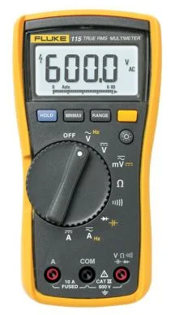
Measuring Voltage and Current
Often when assembling circuits, things can go wrong
It is important to know how to solve these problems
The essential tool for this is a Multimeter
It can be used to measure resistance, voltage, and current easily
Voltage and resistance are measured in parallel while current is measured in series
Another handy feature is the ability to find short circuits

Slide 20

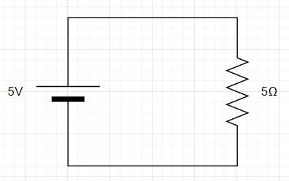

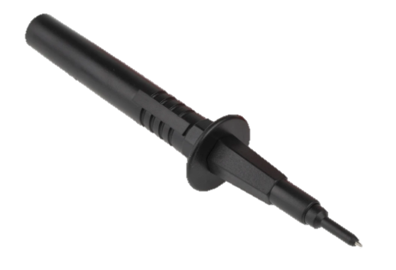
Measuring Voltage
Measuring voltage across a battery
5V

Slide 21
Measuring Voltage
Measuring voltage across a resistor
5V

Slide 22
Measuring Voltage
Measuring voltage on a wire (also use the short circuit setting)
0V

Slide 23
Measuring Resistance
Measuring resistance of a resistor
5Ω

Slide 24

Measuring Current
Measuring current in a circuit
1A

Slide 25
Questions?
Thanks for listening!

